Slide 1
Data structure and Algorithm​ Lesson 8: Searching Algorithm
Aj. Suttinee

Slide 2
Problem
Check whether a given element is in the record or not
Looking for 6
A[0] | A[1] | A[2] | A[3] | A[4] | A[5] | A[6] | A[7] | A[8] | A[9]
8 | 5 | 7 | 10 | 9 | 3 | 2 | 5 | 6 | 1

Slide 3
Linear Search
Worst case time complexity = O(n)
Iteration
Recursion
public static void look(int[] a, int index, int lookupValue){
if(a[index] == lookupValue) { System.out.println("Found"); } else { if (a.length-1 == index) { System.out.println("Not Found"); } else { look(a, index + 1,lookupValue); } } }
int x = 6; int[] array = {8,5,7,10,9,3,2,5,6,1}; for(int i = 0; i<array.length; i++) { if(array[i] == x) { System.out.println("Found"); break; } }

Slide 4


Problem
Looking for 6
A[0] | A[1] | A[2] | A[3] | A[4] | A[5] | A[6] | A[7] | A[8] | A[9]
1 | 2 | 3 | 5 | 6 | 8 | 11 | 15 | 16 | 20

Slide 5
Binary Search
A[0] | A[1] | A[2] | A[3] | A[4] | A[5] | A[6] | A[7] | A[8] | A[9]
1 | 2 | 3 | 5 | 6 | 8 | 11 | 15 | 16 | 20
Works when a list or a record (e.g. array, ) is sorted

Slide 6
Binary Search
Looking for 11
A[0] | A[1] | A[2] | A[3] | A[4] | A[5] | A[6] | A[7] | A[8] | A[9]
1 | 2 | 3 | 5 | 6 | 8 | 11 | 15 | 16 | 20
A[5] | A[6] | A[7] | A[8] | A[9]
8 | 11 | 15 | 16 | 20
Choose the middle index
Check whether it is the key or not
If NOT, check whether the current element is more than or less than the key
mid = low + (high – low)/2;
A[5] | A[6]
8 | 11

Slide 7

Analysis
T(n) = T(n/2) + c
T(8) = T(4) + c
T(4) = T(2) +c
T(2) = T(1) +c
T(1) = 1
T(2) = 1c
T(4) = 2c
T(8) = 3c
Worst Case Time Complexity = C $\log_{2}{n}$
O($\log{n}$)

Slide 8
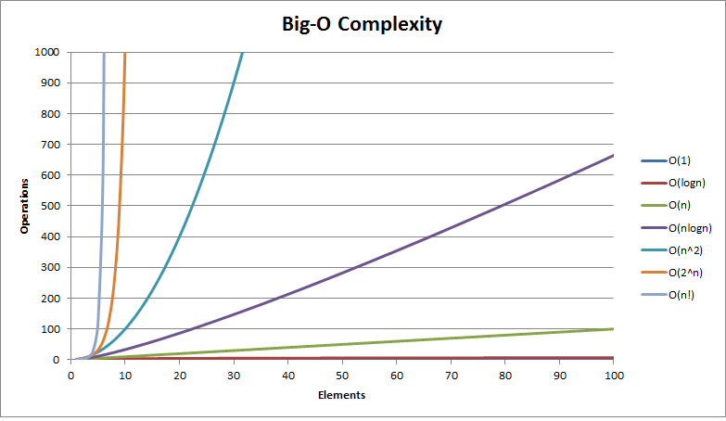
Time Complexity
Time complexity
Input (n)
https://fizalihsan.github.io/technology/algorithms.html

Slide 9
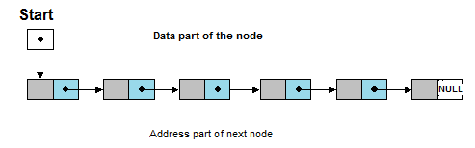
Search in Linked List
Worst case time complexity = O(n)

Slide 10

Binary Search Tree
https://visualgo.net/en/bst
Worst case time complexity
O(n)
Sorted tree = O($\log{n}$)

